Slide 1

Digital Signal Processing
Course Instructor
Dr. Ali J. Abboud
Lecture No. 1: Introduction
Third Class
Department of Computer and Software Engineering
http://www.engineering.uodiyala.edu.iq/
https://www.facebook.com/Engineer.College1

Slide 2
Course Overview
Signals and Systems.
Classification of Discrete Digital Systems.
Time and Frequency Domains Analysis.
Signal Transformation Methods: Fourier, Wavelet and Z-transform.
Digital Filter Types: FIR and IIR Filters.
Digital Filter Design.
Analog Filter Design.
DSP Applications.

Slide 3
Books
J.G. Proakis and D.G. Manolakis, Digital Signal Processing, 4rd edition, Prentice-Hall , 2006.
R.G Lyons, Understanding Digital Signal processing, 3rd edition, Prentice-Hall, (Amazon’s top-selling for five straight year) ,2011.
Monsons Hays, Schaums Outline of Digital Signal processing, 2nd edition ,McGraw-Hill Companies, 2012.
Richard, The Essential Guide to Digital Signal Processing, 1st edition Prentice-Hall ,ePUB, 2014.
J.G. Proakis , Digital Signal Processing Using MATLAB, 3rd edition, Cengage Learning , 2012.

Slide 4
What is Digital Signal Processing?
Signal: It can be broadly defined as any physical quantity that varies as a time and/or space and has the ability to convey information, examples of these signals are:
Electrical signals: currents and voltages in AC circuits, radio communications signals, video signals etc.
Mechanical signals: sound or pressure waves, vibrations in a structure, earthquakes, etc.
Biomedical signals: electro-encephalogram, lung and heart monitoring, X-ray and other types of images.
Finance: time variations of a stock value or a market index.
Digital Signal: operating by the use of discrete signals to represent data in the form of numbers.

Slide 5
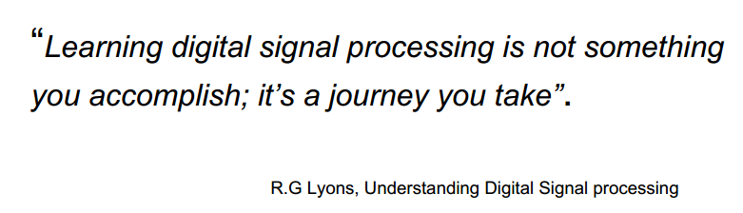
What is Digital Signal Processing?
Processing: a series operations performed according to
programmed instructions.

Slide 6
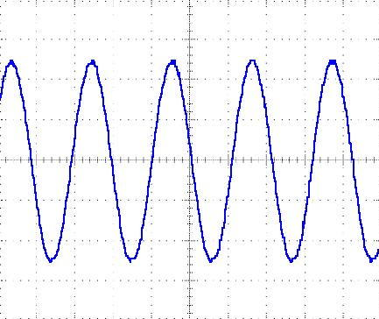
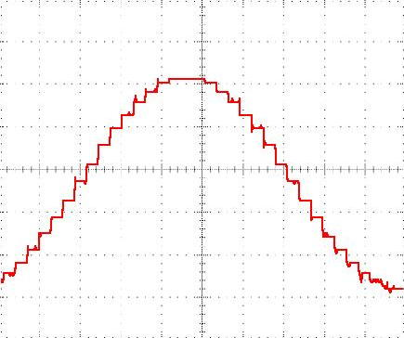
What is Digital Signal Processing?
Converting a continuously changing waveform (analog) into a series of discrete levels (digital)

Slide 7
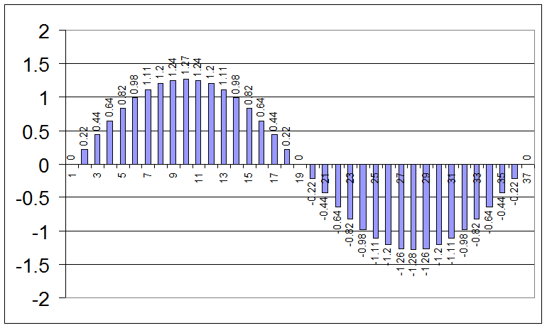
What is Digital Signal Processing?

Slide 8
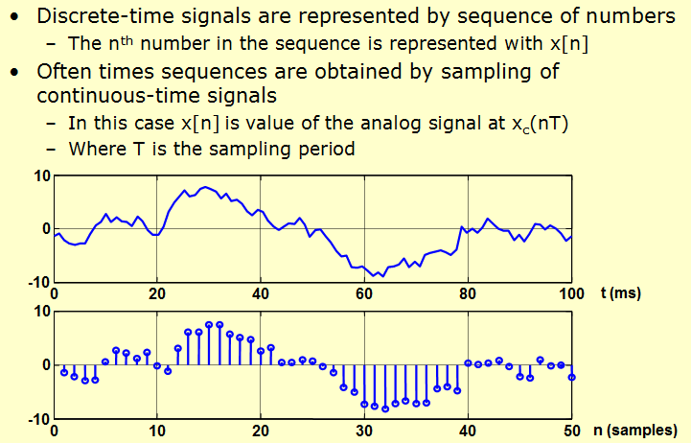
What is Digital Signal Processing?

Slide 9
What is Digital Signal Processing?
discrete signal is discrete in time but continuous in amplitude.
digital signal is discrete in both time and amplitude.

Slide 10
The Concepts of Signals and Systems
The most convenient mathematical representation of a signal is via the concept of a function, say x(t). In this notation:
x represents the dependent variable (e.g. voltage, pressure, etc.)
t represents the independent variable (e.g. time, space, etc.).
Depending on the nature of the independent and dependent variables, different types of signals can be identified such as:
Analog signals
Discrete signals
Digital signals
Multi-channel signals
Multi-dimensional signals

Slide 11

The Concepts of Signals and Systems
System: A physical entity that operates on a set of primary signals (the inputs) to produce a corresponding set of resultant signals (the output).
The operations, or processing, may take several forms: modification, combination, decomposition, filtering, extraction of parameters, etc.
System characterization: a system can be represented mathematically as a transformation between two signal sets , as in x[n] → y[n]:

Slide 12
The Concepts of Signals and Systems

Slide 13
The Concepts of Signals and Systems

Slide 14

Basic components of a DSP System
In its most general form, a DSP system will consist of three main components, as illustrated below:
The analog-to-digital (A/D) converter transforms the analog signal x_{c}(t) at the system input into a digital signal x_{d}[n].
The digital system performs the desired operations on the digital signal x_{d} [n] and produces a corresponding output y_{d} [n] also in digital form.
The digital-to-analog (D/A) converter transforms the digital output y_{d} [n] into an analog signal y_{c} (t) suitable for interfacing with the outside world.

Slide 15
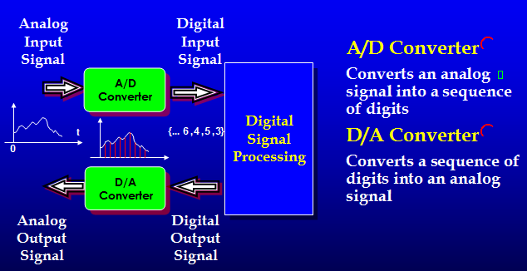
Basic components of a DSP System

Slide 16
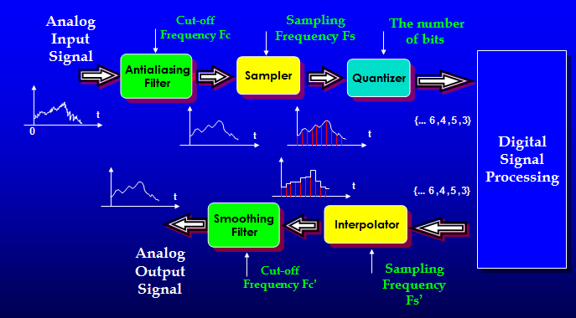
Basic components of a DSP System

Slide 17
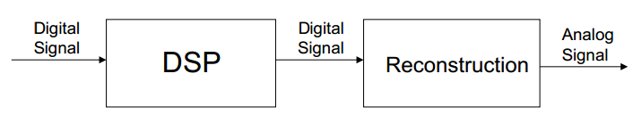
DSP Implementation –Analog/Digital Conversion
To implement DSP we must be able to:
(1) perform numerical operations including, for example, additions, multiplications,
data transfers and logical operations either using computer or special-purpose
hardware.
(2) convert the digital information, after being processed back to an analog signal –
involves digital-to- analog conversion and reconstruction .
e.g. text-to-speech signal (characters are used to generate artificial sound)

Slide 18
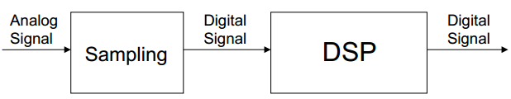
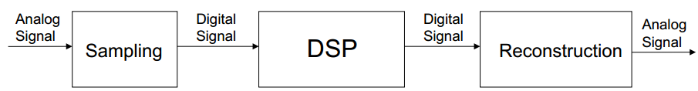
DSP Implementation –Analog/Digital Conversion
To implement DSP we must be able to:
3) convert analog signals into the digital information - sampling & involves analog-to-digital conversion.
e.g. Touch-Tone system of telephone dialling (when button is pushed two sinusoid signals are generated (tones) and transmitted, a digital system determines the frequencies and uniquely identifies the button – digital (1 to 12) output
perform both A/D and D/A conversions
e.g. digital recording and playback of music (signal is sensed by microphones, amplified, converted to digital, processed, and converted back to analog to be played.

Slide 19
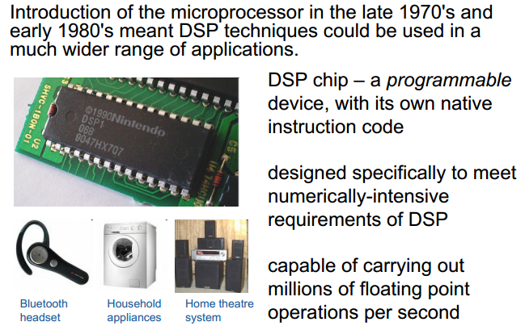
DSP Chips : Special Purpose Hardware

Slide 20

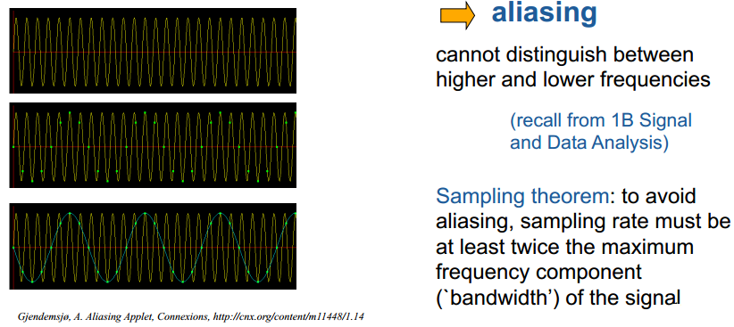
Limitations of DSP-Aliasing
Most signals are analog in nature, and have to be sampled.
we only take samples of the signals at intervals and don’t know what happens in between

Slide 21
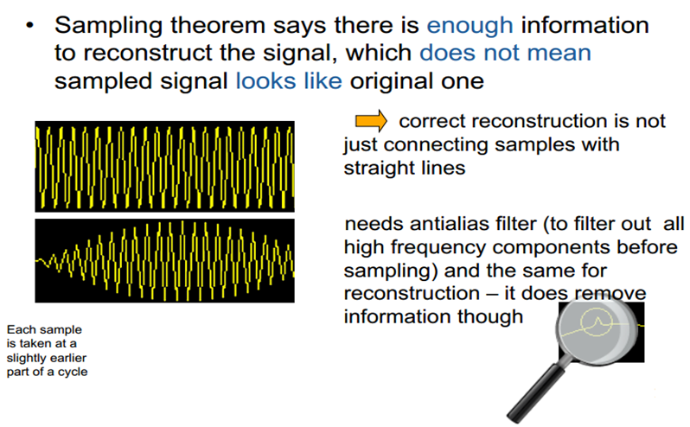
Limitations of DSP - Antialiasing Filter

Slide 22
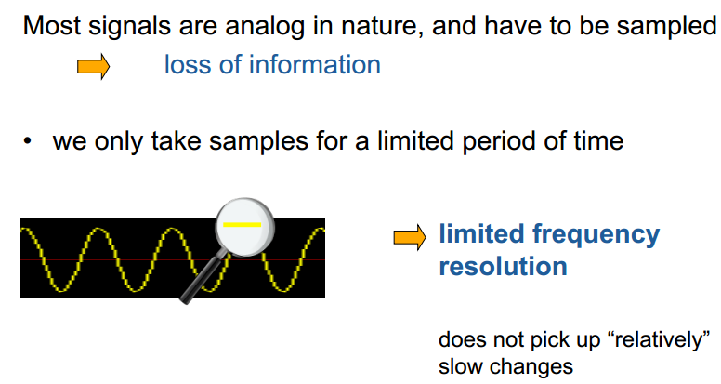
Limitations of DSP – Frequency Resolution

Slide 23
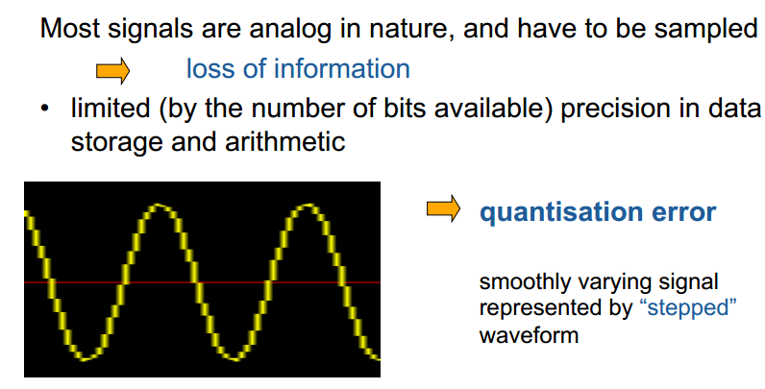
Limitations of DSP – Quantization Error

Slide 24
Advantages of Digital over Analog Signal Processing
Why still do it?
• Digital system can be simply reprogrammed for other applications / ported to different hardware / duplicated (Reconfiguring analog system means hardware redesign, testing, verification)
• DSP provides better control of accuracy requirements (Analog system depends on strict components tolerance, response may drift with temperature)
• Digital signals can be easily stored without deterioration (Analog signals are not easily transportable and often can’t be processed off-line)
• More sophisticated signal processing algorithms can be implemented
(Difficult to perform precise mathematical operations in analog form)

Slide 25
Advantages of Digital over Analog Signal Processing
Advantages:
Robustness:
Signal levels can be regenerated.
Precision not affected by external factors
Storage capability:
DSP system can be interfaced to low-cost devices for lasting storage
allows for off-line computations
Flexibility:
Easy control of system accuracy via changes in sampling rate and number of representation bits.
Software programmable → reconfiguring the DSP operations simply by changing the program.
Structure:
Easy interconnection of DSP blocks (no loading problem)
Possibility of sharing a processor between several tasks
Disadvantages:
Cost/complexity added by A/D and D/A conversion.
Input signal bandwidth is technology limited.
Quantization effects.

Slide 26
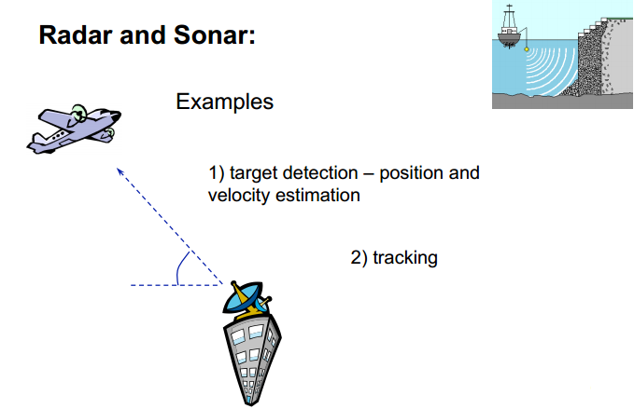
Applications of DSP-Radar

Slide 27
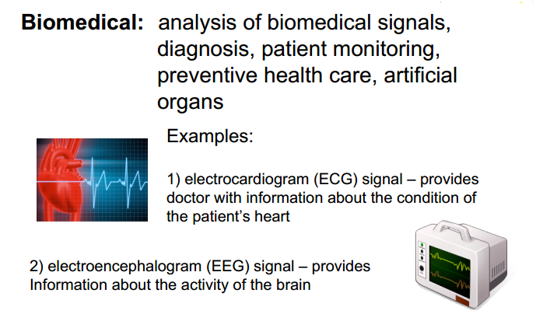
Applications of DSP: Biomedical

Slide 28
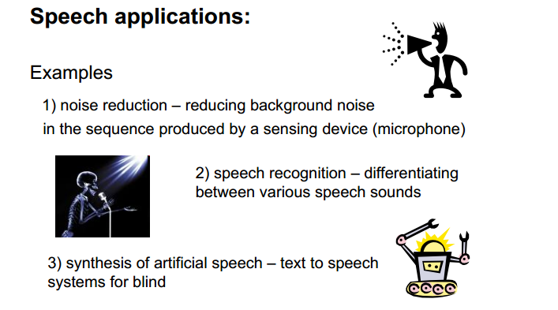
Applications of DSP: Speech

Slide 29
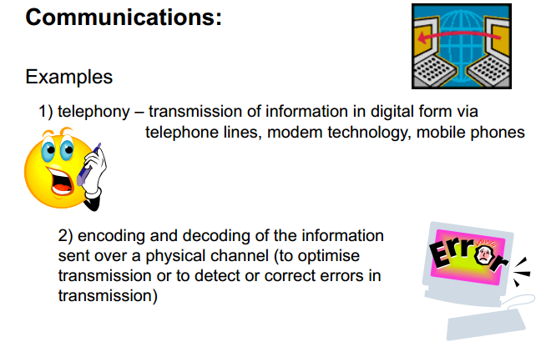
Applications of DSP: Communications

Slide 30
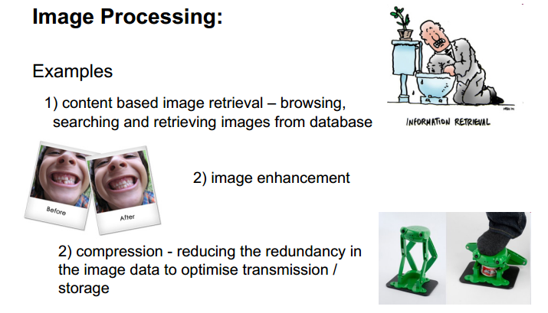
Applications of DSP: Image Processing

Slide 31
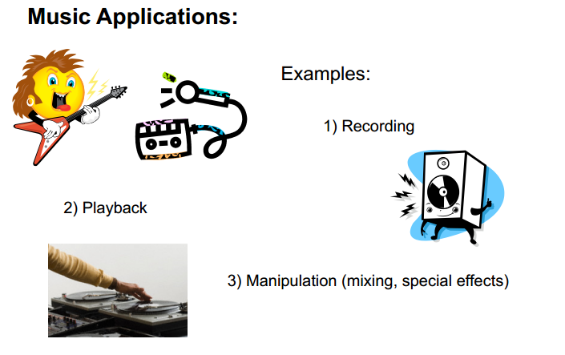
Applications of DSP: Music

Slide 32
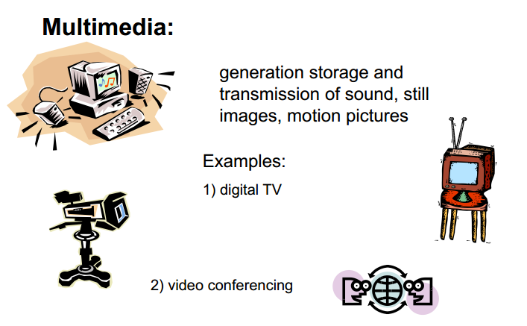
Applications of DSP: Multimedia

Slide 33
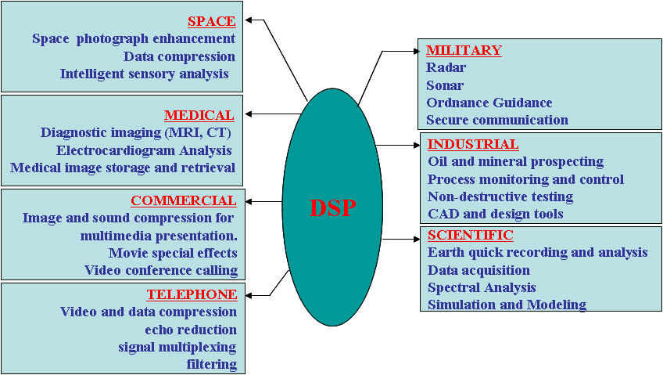
Applications of DSP

